Slide 1

At the heart of British supply chains

Slide 2
The basics of Gemba Walks
What is expected from this training?
What is a Gemba Walk?
Tools to help identify waste within processes
The Gemba Walk process
Live Gemba Walk
Feedback from the Gemba Walk and wrap up

Slide 3

What are Gemba Walks?
現場
= Gemba Walk
“Go to where the action is and look through Lean Eyes”
Developed by Taiichi Ohno, the father of Just in Time production

Slide 4

Where to do a Gemba Walk?
Everywhere!
Including:
Goods In
Decant
Replenishment/Tramming
Picking Areas (THS/GTP/APR)
Marshalling
Loading/Despatch
Admin
Any area going through change or 5S

Slide 5
What are we looking to identify?
What is Process waste and how can you identify it?
Remove
Each process/task can broken down into three categories.
Maximise
Process waste is found in these two sections.
Defined as any steps in a process which do not add value to the overall task.
Value Enabling
The Waste in the process can be categorised into 8 different wastes; often referred to as TIMWOODS.
Minimize

Slide 6
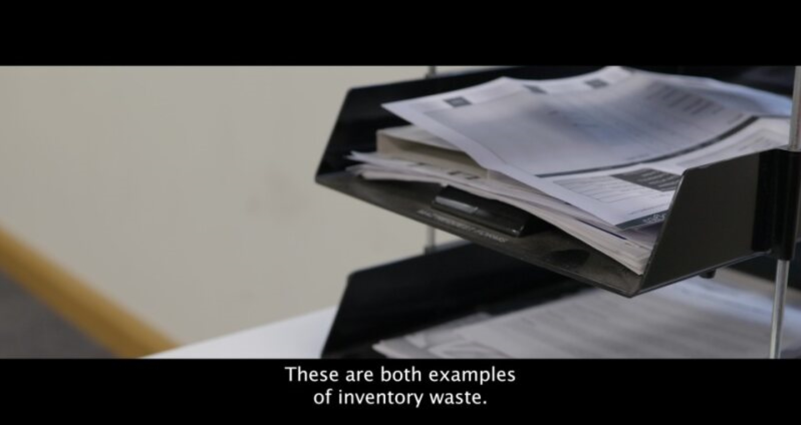
Different Types of Waste
TIMWOODS –Process Waste

Slide 7



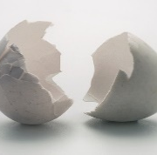




Different Types of Waste
Use TIMWOODS to identify and minimise waste:
Transport
Motion
Over - Processing
Defects
Unnecessary transport of items
Unnecessary transport or movement of people
Doing more steps in a process than is required
Not right first time
Inventory
Waiting
Over-Production
Skills
Surplus of items held
Available but unable to process/proceed
Exceeding requirements
Underutilising peoples natural capabilities

Slide 8

Transport
The unnecessary movement of products, equipment, and people results in time being wasted.
Where products are handled more (or transported more than is necessary) they are at a greater chance of being damaged.
Increased Transport also increases the wear and tear on machinery, increasing the cost of operation.
Example:
Loading product from a Despatch grid that isn’t adjacent to the Loading Bay.
This adds unnecessary travel and wasted time that could be avoided.

Slide 9

Inventory
Having too much inventory can lead to longer lead times, damaged or defected products, and an inefficient use of capital.
Trying to maintain excessive inventory means reducing available storage space and utilising extra resources just to manage it.
Example:
Ensuring Master Data Checks are undertaken correctly so the stock balance is correctly measured

Slide 10

Motion
Unnecessary motion involves people moving unnecessarily to retrieve equipment, product or machinery.
The movement could be any motion in the process, such as moving, stretching, bending, reaching, lifting and walking, that doesn’t add any value to the process.
Removing unnecessary motion from a process helps to improve productivity and ensure safety is maximized.
Example?
Equipment not located where the activity takes place(5S is a tool that can improve this).

Slide 11

Waiting
Waiting is often an overlooked waste and can occur any time within the process where product or people are waiting for the next stage of the process.
Waiting can be caused by:
Machinery downtime
Waiting for approval/checks
Resourcing imbalance (ineffective VS Takt Time)
Congestion
Example?
Colleagues waiting to be deployed or be given the necessary equipment to undertake their role.

Slide 12

Over-Processing
Overprocessing often involves actions or activity being repeated, or processes being overengineered and involving many more steps than are required to reach the same output.
Some processes may in their entirety be classified as overprocessing, if the output is no longer a requirement.
Example:
Reports being generated and distributed that are no longer utilised.
Excessive packaging being applied to products (tape etc.)
Undertaking more checks than are necessary for the process

Slide 13

Over-Production
Overproduction often occurs when more products or materials are produced than is required by the customer.
Overproduction leads to further wastes in Motion, Waiting and Inventory.
A Just-in-Time system of working helps to reduce these unnecessary wastes, by focusing on the product that is required and working on this at the right time to hit the required deadline.
Example:
Resourcing an area too heavily for the work that is available and leading to the area picking out.

Slide 14
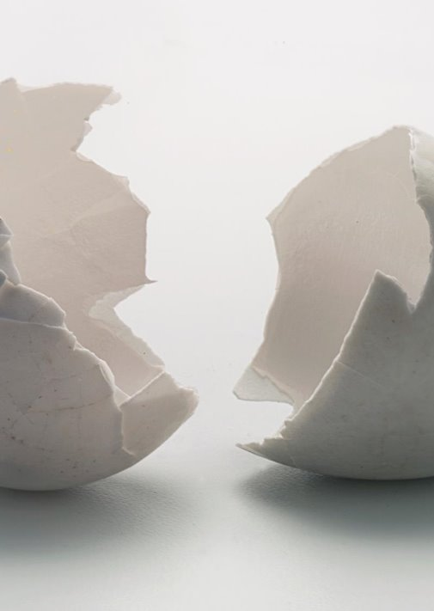
Defects
Defects could be considered the worst of the seven wastes.
These can be described as products that do not meet the required standards, or products that must either be scrapped or reworked, thus adding costs to the operation but not adding value for the customer.
Example:
Picking the wrong product
Not packaging a product correctly leading the product to be damaged and unsaleable

Slide 15

Skills
Skills was not an original waste within the TIMWOODS methodology, and is often overlooked.
This type of waste occurs when workers and their skillsets are not used to their full extent.
This can include not using their known skillset, but can also be not using the wealth of experience that workers have with the processes they do on a daily basis.
Workers are one of the biggest assets of any organisation and engaging with them and giving them a voice, empowers them, and can support in improving processes.
Example:
A new colleague who has prior MHE experience is overlooked, at a time when there is a shortage of drivers.

Slide 16
Let’s see this in action
TIMWOODS Exercise

Slide 17
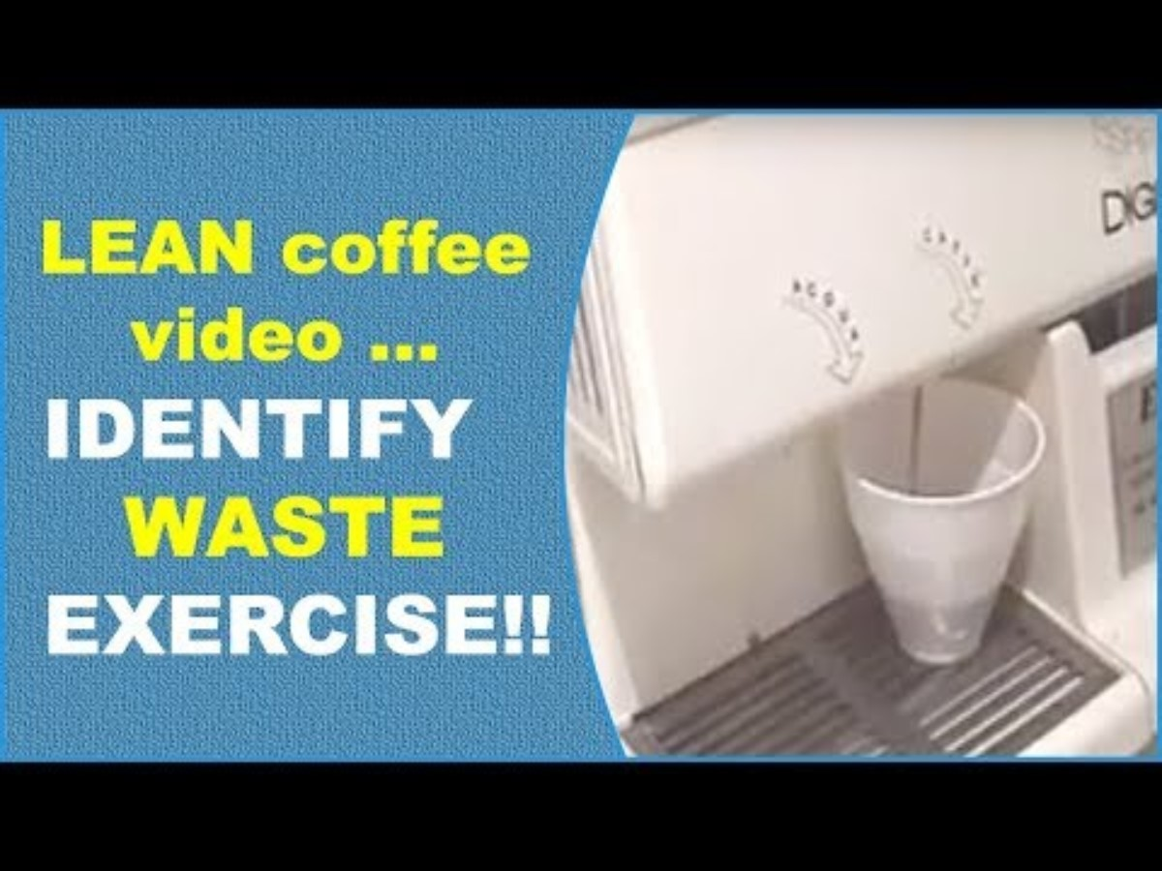
Let’s see this in action
TIMWOODS Exercise

Slide 18
Confident in identifying wastes?
TIMWOODS Exercise

Slide 19


Slide 20


What to do during Gemba Walks
Pre-Meeting with those involved, explain to the colleagues involved the aim of the Gemba walk
Observe a team member performing their job for at least 30 minutes
Take notes regarding what is done, where there is waste (TIMWOODS)
If you see something that can be improved, make a note of this for discussion afterwards
Record any production / performance metrics that are completed
Record any avoidable delays (things that could be avoided)

Slide 21





1
2
3
4
5
Set the theme
Set the theme of the walk
Engage and Involve
Prepare the Team
Let the team know the steps
Ensure understanding of the value stream
Do the Walk
Record Observations
(Focus on Process not People)
Evaluate the findings
Review and discuss what has been found amongst the team including the colleague(s) involved
Make it Lean
Report observations/ findings to CI Team to ensure follow up actions
Notes:
Set the theme between the Team of what is being looked at (this could be borne from customer feedback on an area of the business VOC)
Prepare the Team – An understanding of how the Gemba walk feeds into CI is essential
Focus on Process and NOT people
Focus on Processes that are part of the value stream of the organisation i.e. repeated activites (THS Picking)
Record Observations during the Gemba Walk. Don’t feedback during the walk (this can disrupt what you might see going forward on the Gemba Walk)
The Gemba walk can be completed by one person, but is often best completed with someone from another department, who may see things that you may not
Follow Up afterwards – Involve the Colleague

Slide 22


Any Questions?

